Slide 1
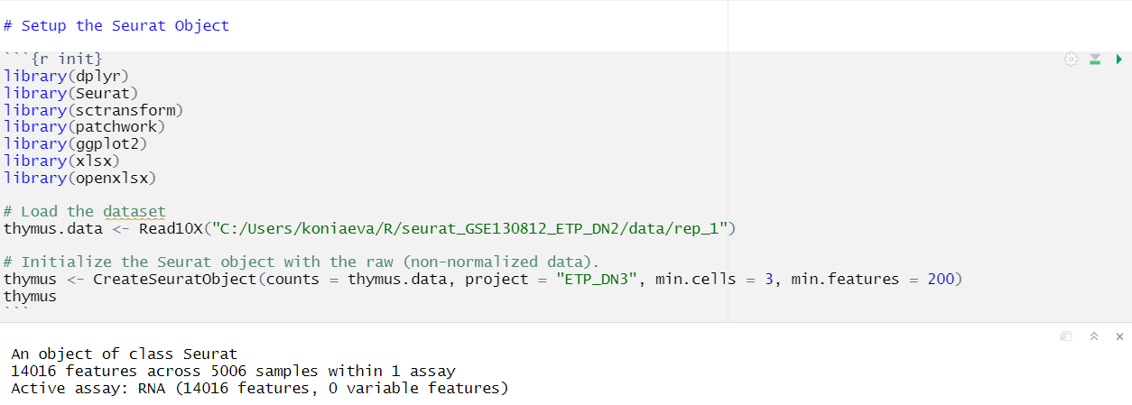
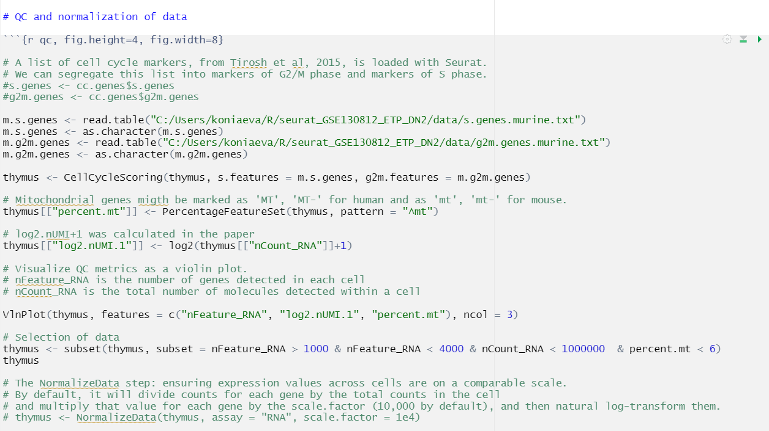
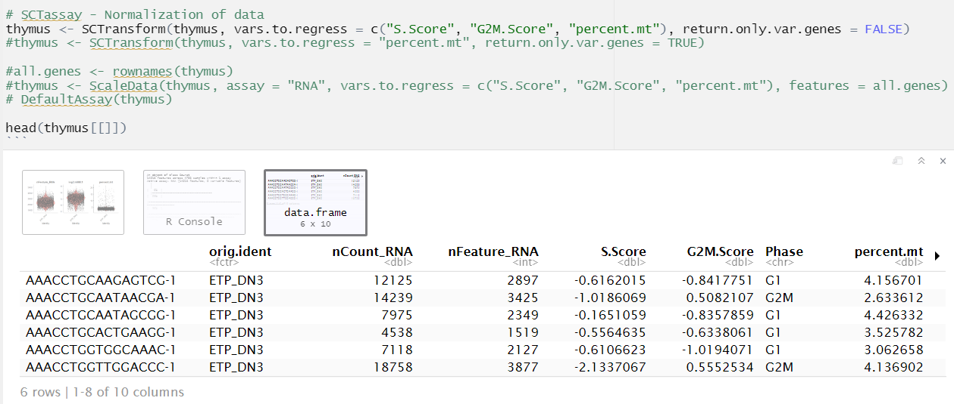

Slide 2
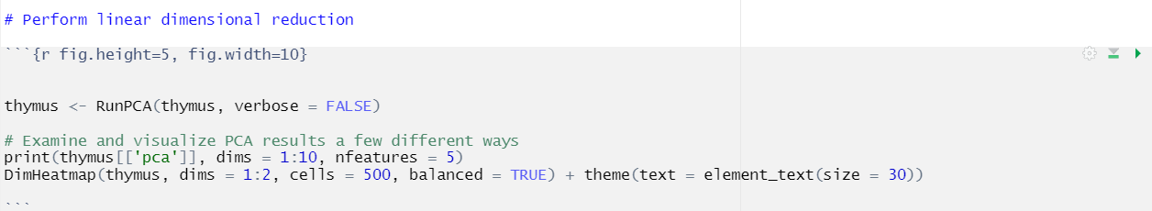
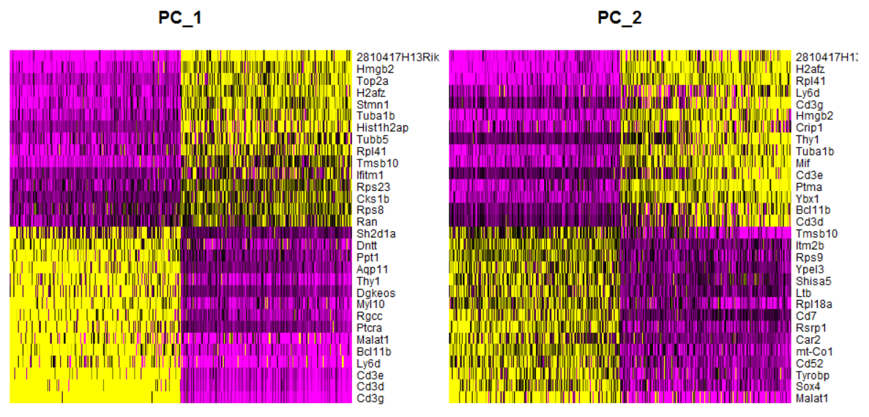
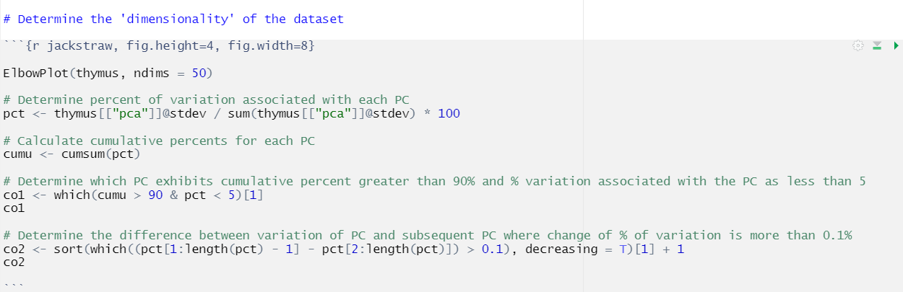
PC_ 1 Positive: Cd3g, Cd3d, Cd3e, Ly6d, Bcl11b
Negative: 2810417H13Rik, Hmgb2, Top2a, H2afz, Stmn1
PC_ 2 Positive: Malat1, Sox4, Tyrobp, Cd52, mt-Co1
Negative: 2810417H13Rik, H2afz, Rpl41, Ly6d, Cd3g
PC_ 3 Positive: Cd3g, Cd3d, Cd3e, Eef1a1, Rpl18a
Negative: Hbb-bt, Malat1, Plac8, Crip1, Il2ra
PC_ 4 Positive: 2810417H13Rik, Plac8, Hbb-bt, Hist1h2ap, Top2a
Negative: Actb, Cbx3, Tubb5, Cdk6, Rpgrip1
PC_ 5 Positive: Ifitm1, Eif5a, Eif4a1, Ran, Cenpa
Negative: Actb, 2810417H13Rik, Tubb5, Malat1, Hist1h2ap
PC_ 6 Positive: Plac8, Actb, Lgals1, Hist1h2bc, Dntt
Negative: Malat1, Cd3d, Hbb-bt, 2810417H13Rik, Xist
PC_ 7 Positive: Isg15, Rtp4, Ifit1, Oasl2, Usp18
Negative: Hbb-bt, Eef1a1, Actb, Rpl3, Rplp0
PC_ 8 Positive: Hbb-bt, Cd3d, Cd3g, Cd3e, Actb
Negative: Malat1, Crip1, Plac8, Ly6d, Cpa3
PC_ 9 Positive: Prtn3, Mpo, Ctsg, Ccl9, Ms4a3
Negative: Crip1, Ly6d, Tmsb10, Il2ra, Isg15
PC_ 10 Positive: Myl10, Ifitm1, Ptcra, Hist1h2bc, Rag1
Negative: Gzma, Thy1, Sh2d1a, Lef1, Id3

Slide 3
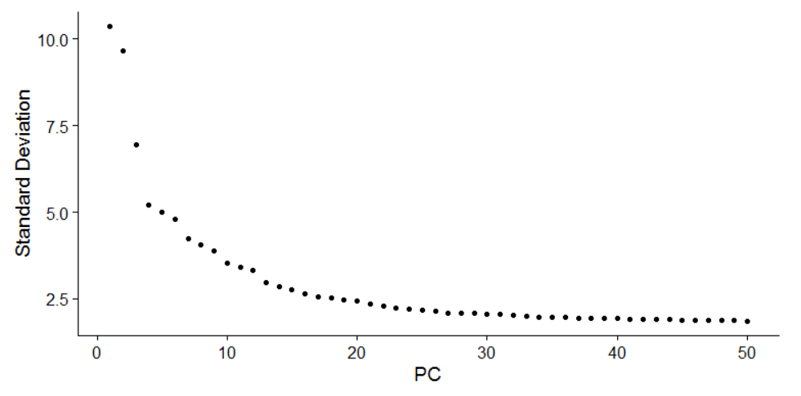
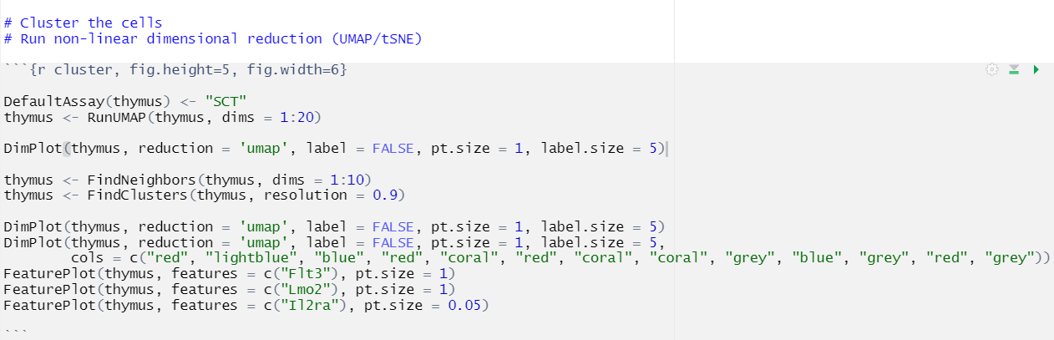
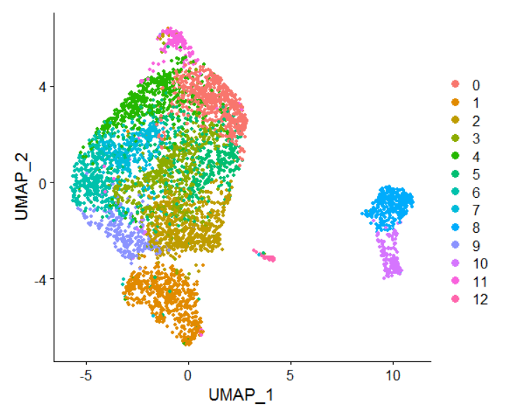
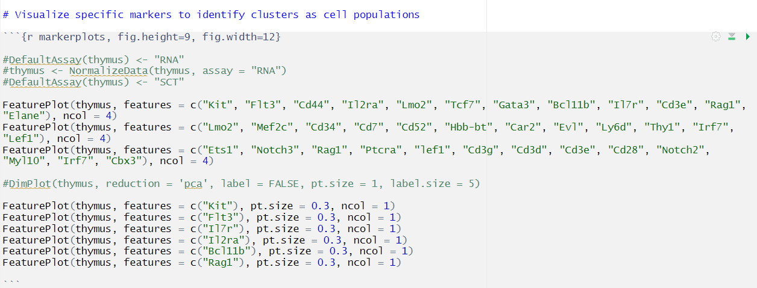

Slide 4
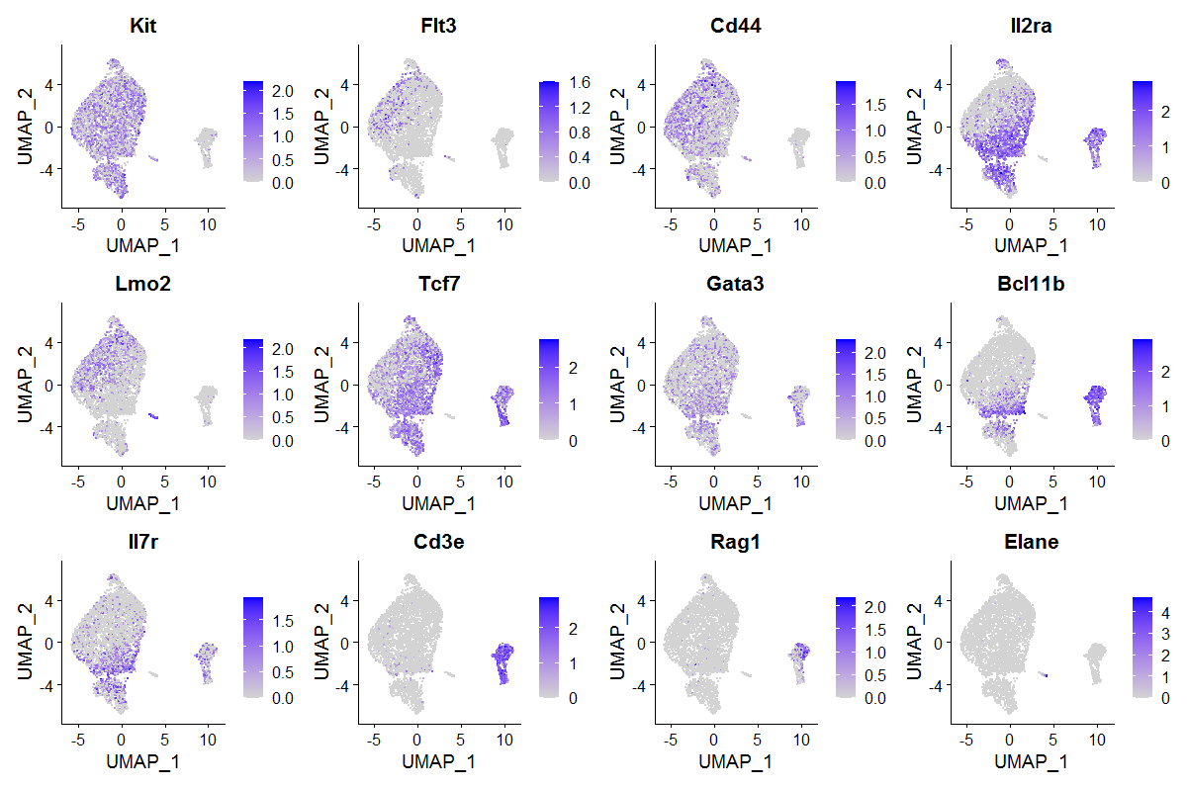
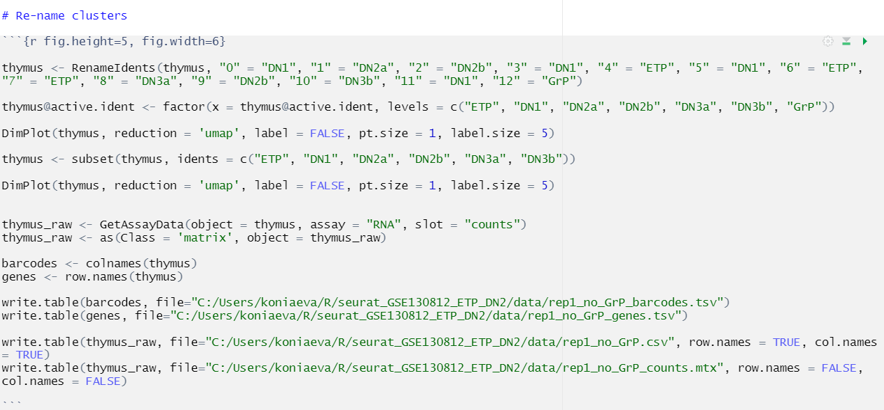
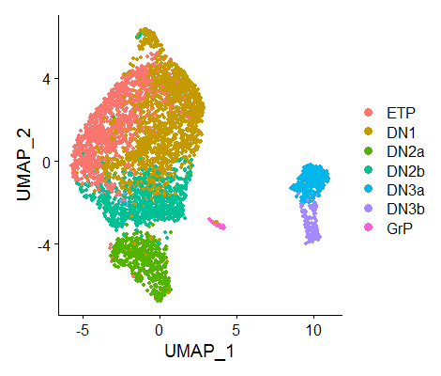

Slide 5
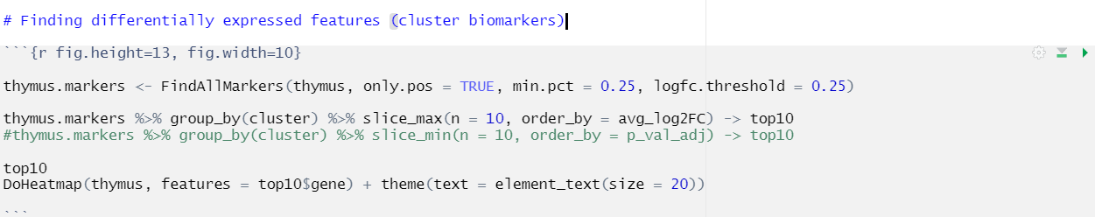
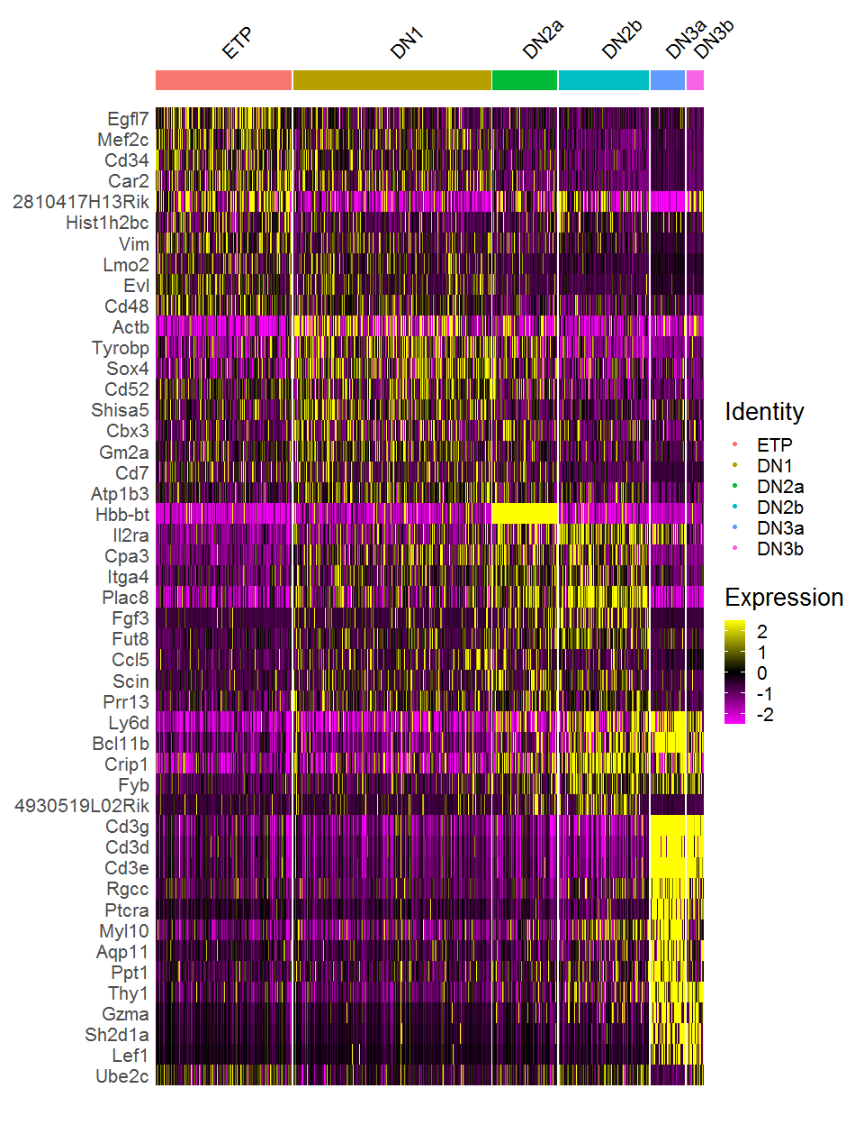

Slide 6
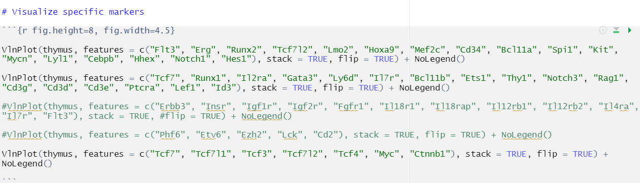
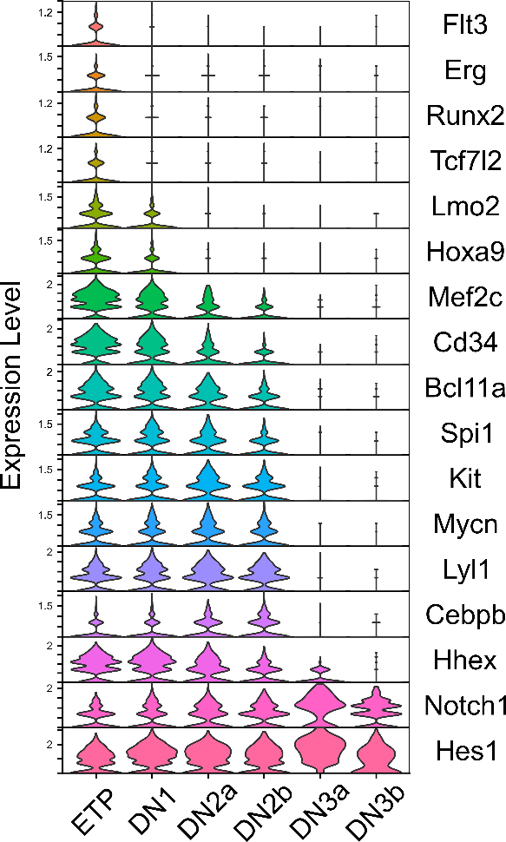
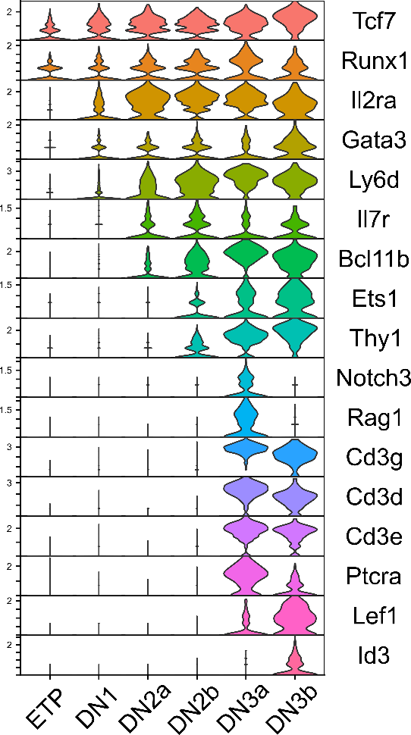
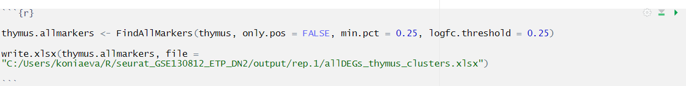
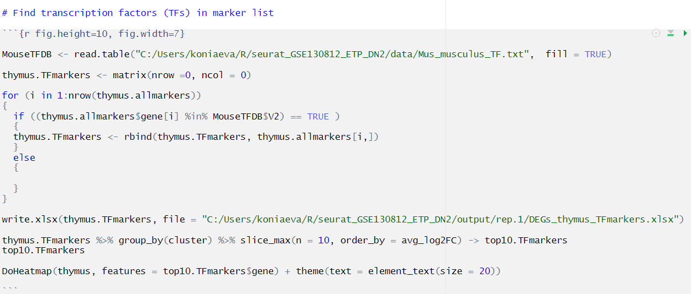

Slide 7
